Slide 1

Team Members
Arun
Chandra
Dhanraj
Nagamallika
Nagaraj
Naveen

Slide 2
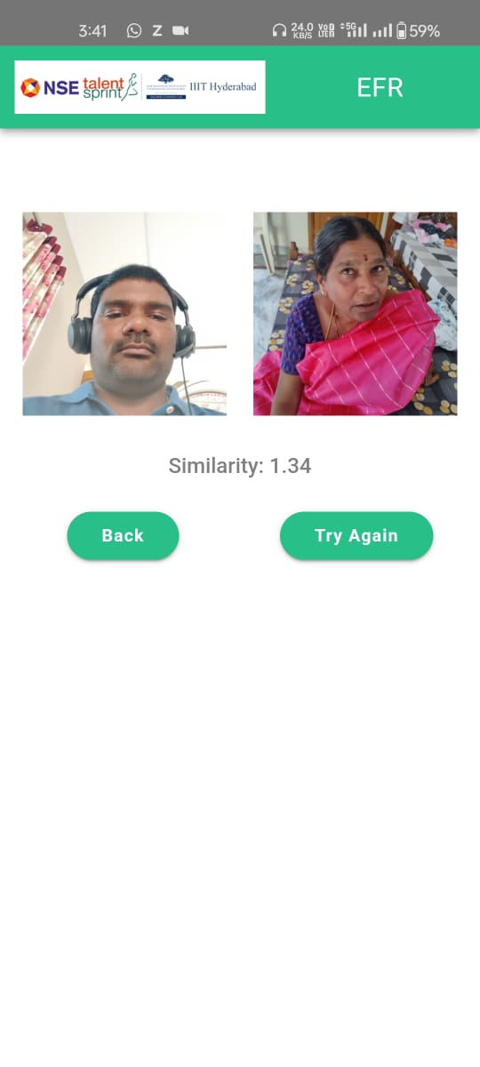
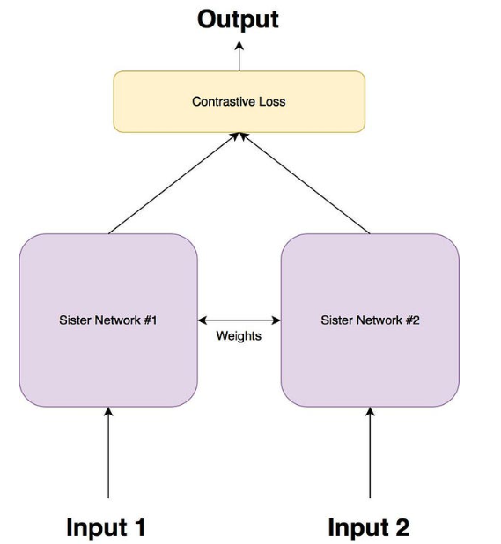
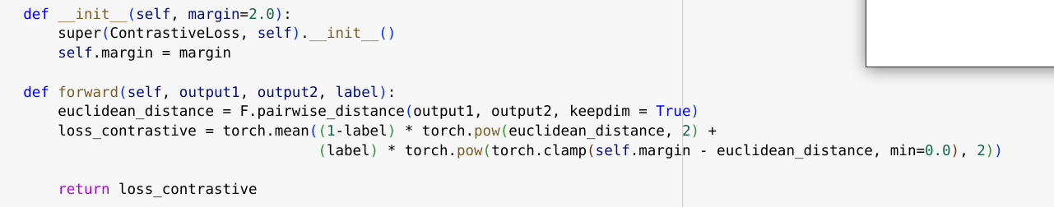
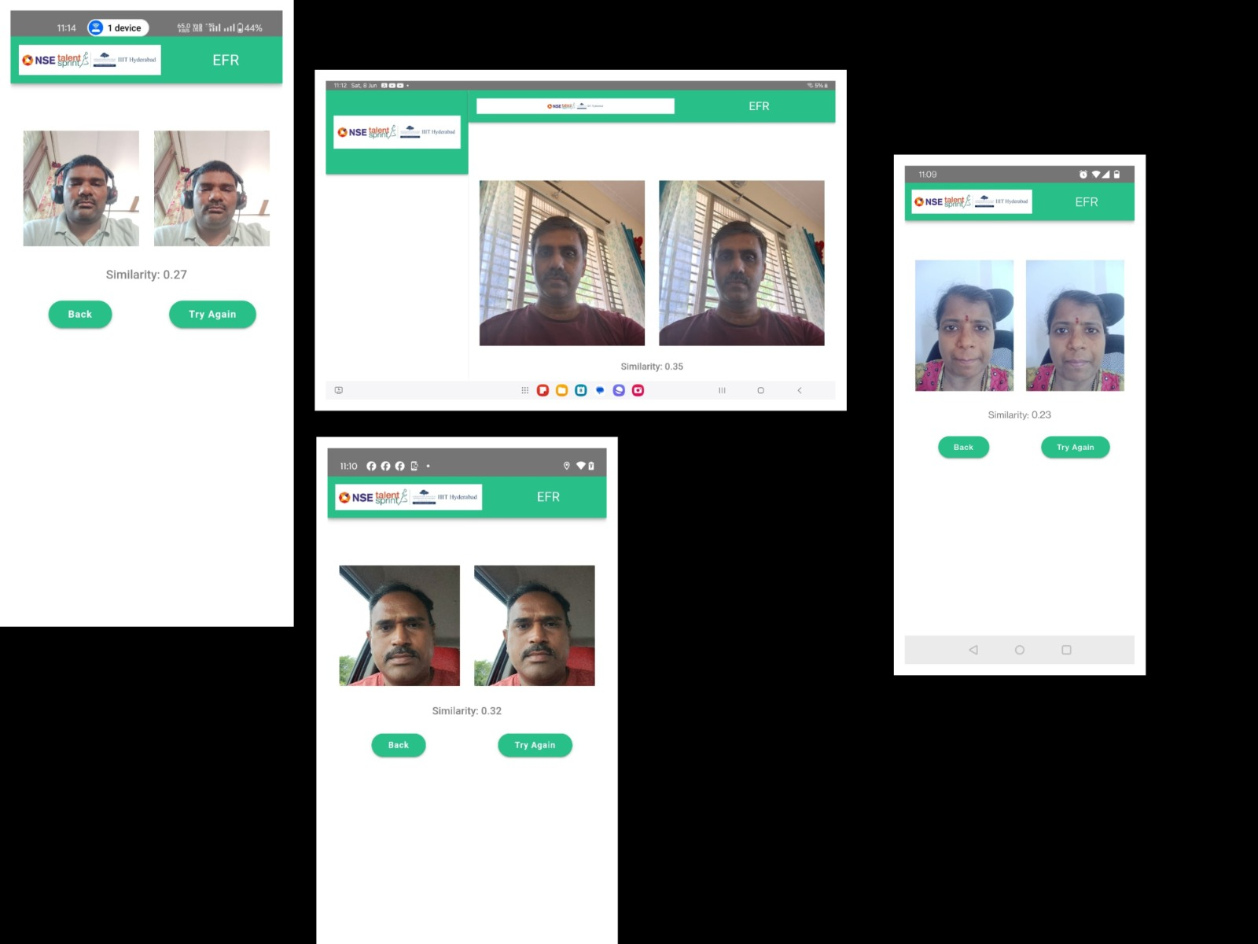


Image Similarity
Siamese Network

Slide 3


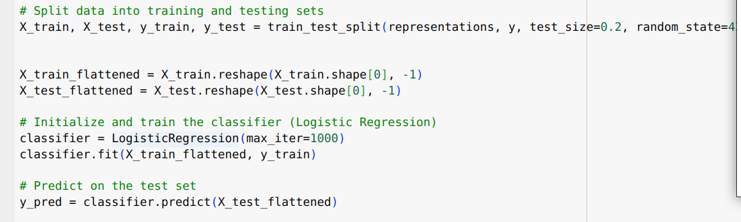
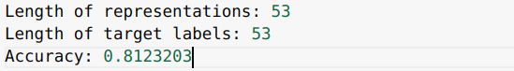
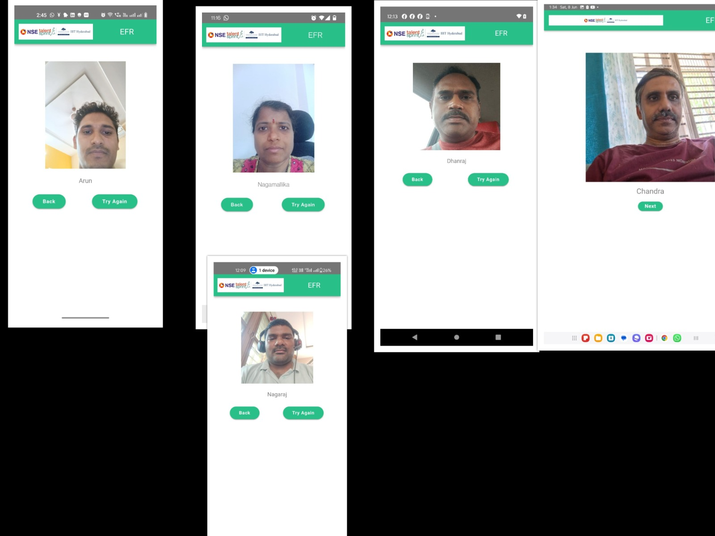
Face Reconition
Person 1
Person 2
Person 3
Person 2
Person 4
LogisticRegression
(Classifier)
Features
Siamese Network
Image 1

Slide 4
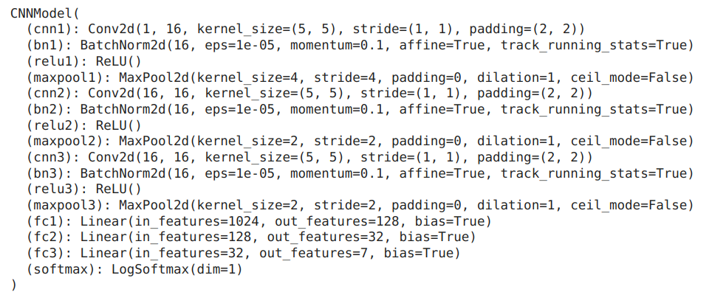




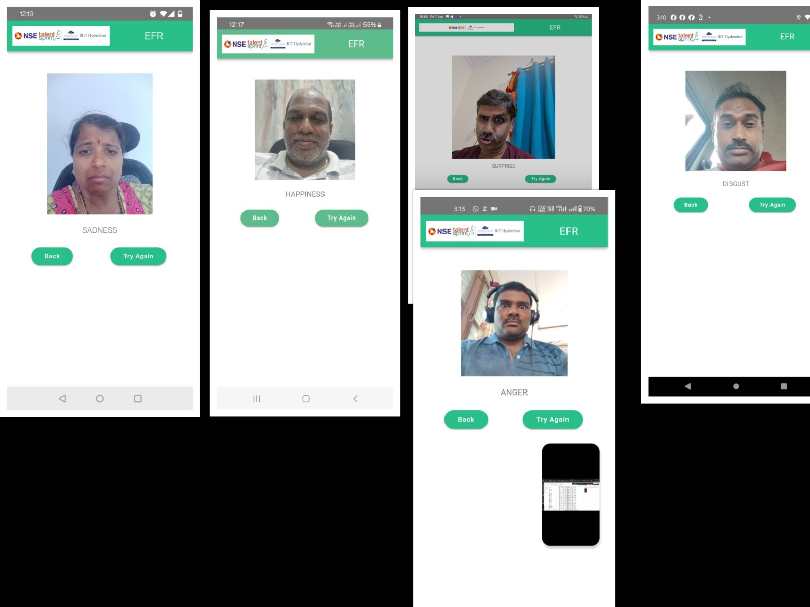
Expression Recognization
CNN Model

Slide 5
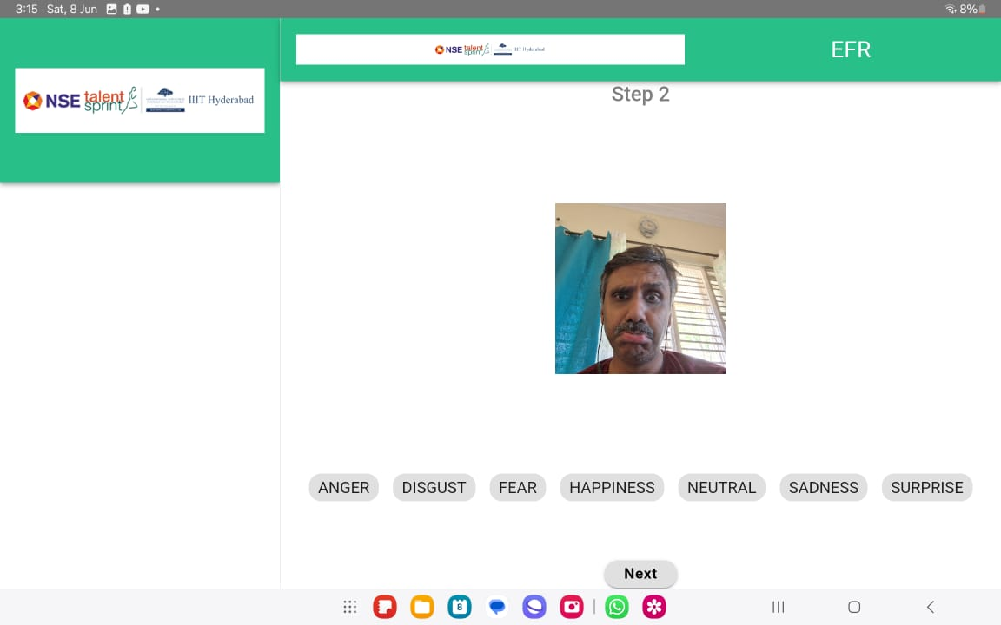

Expression Sequence
CNN Model
CNN Model
CNN Model
CNN Model

Slide 6
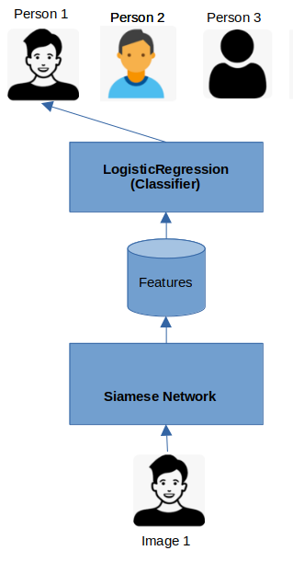
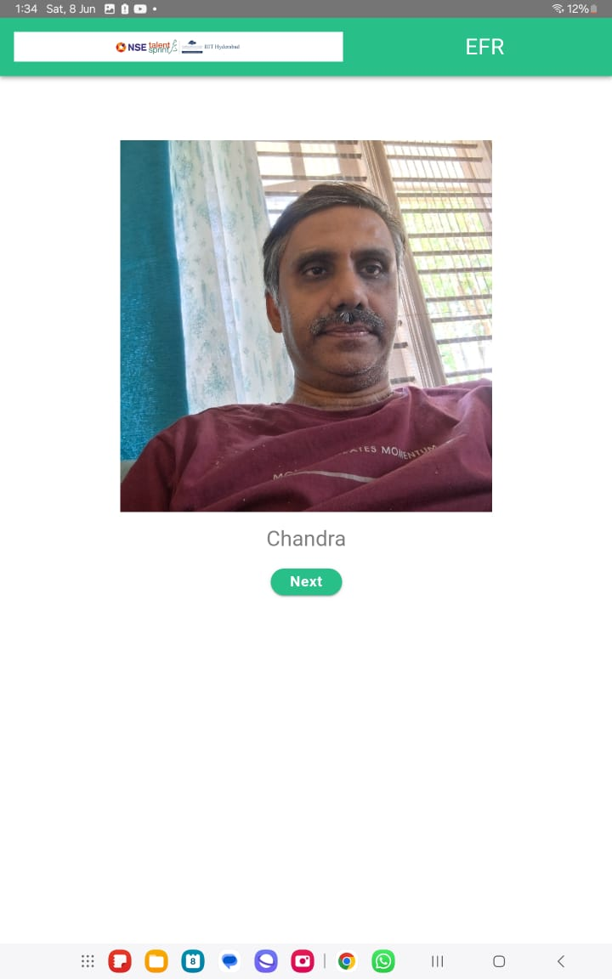

Face and Expression
CNN Model

Slide 7
Results

Slide 8
Thank You

